Slide 1
Slides to understand better how to do overshot/undershot simulations for-loops (and minimize the number of simulations needed to be run).

Slide 2
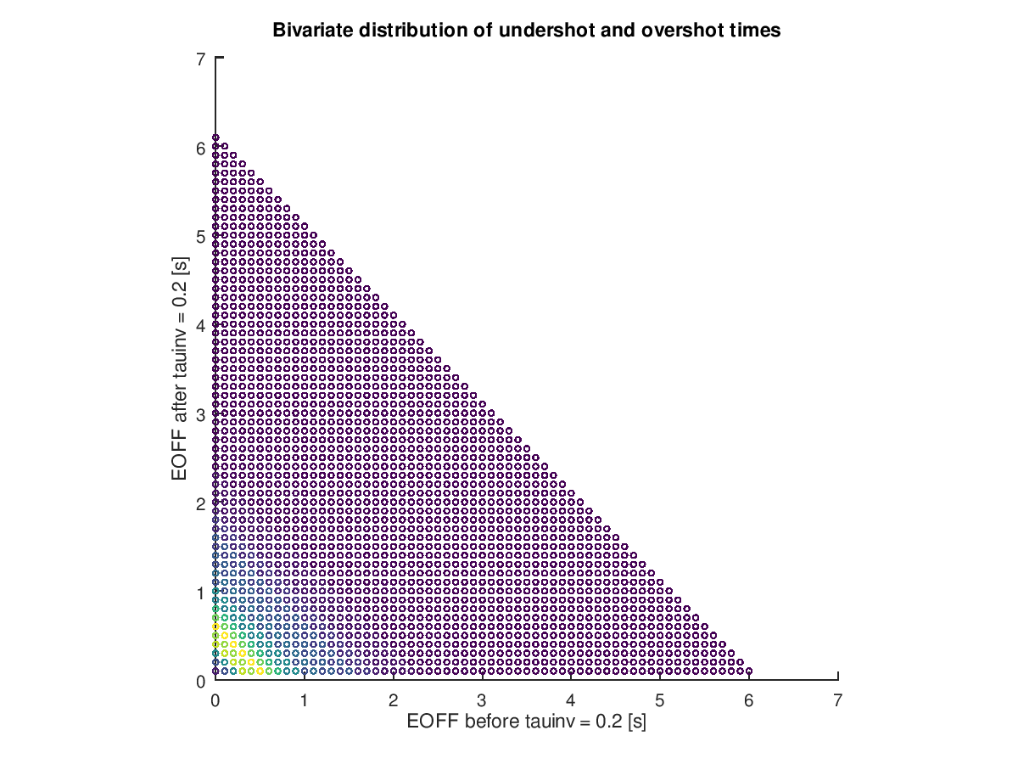
A simple threshold model, where the undershot does not matter
All of these are non-crashes
Simulations that needs to be run
All points has a probability (➔ weight)
I actual think this is what the simulations of most events, even with accumulation models, will look like

Slide 3
An accumulation model where the undershot matters
All of these are non-crashes
Simulations that needs to be run. And here, all simulations really need to be run (exception, see slide 6)

Slide 4
The following two pages are two versions of how I think you may be doing your simulations today (that you are “only” running the sims along the green lines), but I actually do not think either is correct.
Can you show how you are doing it today in a similar drawing?

Slide 5
A simple threshold model, where the undershot does not matter
All of these are non-crashes
Simulations that needs to be run
All points has a probability (➔ weight)
Are these the sims you are running now (with the 1s skip) – I do not think so, but wanted to show an example..

Slide 6
A simple threshold model, where the undershot does not matter
All of these are non-crashes
Simulations that needs to be run
All points has a probability (➔ weight)

Slide 7
An accumulation model where the undershot matters
All of these are non-crashes
Simulations that needs to be run.
These may be simulations where the crash happens without the driver acting at all (will not have time) – if we really want to optimize, we should not have to run these either (only one, to get the impact speed). That is, the driver glance behaviour does not matter

